Slide 1
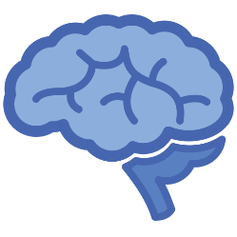
CNN for image classification: The concept of Knowledge transfer

Slide 2
Transfer Learning
Transfer learning consists in using a pretrained model on a new problem
The knowledge of an already trained model is applied to a different but related problem:
the aim is exploit what has been learned in one task to improve generalization in another
The general idea is to use the knowledge a model has learned from a task with a lot of available labeled training data in a new task that doesn't have much data
Notes:
Introduction to transfer learning:
Humans use transfer leaning every day exploiting past learned knowledge to solve new problems

Slide 3
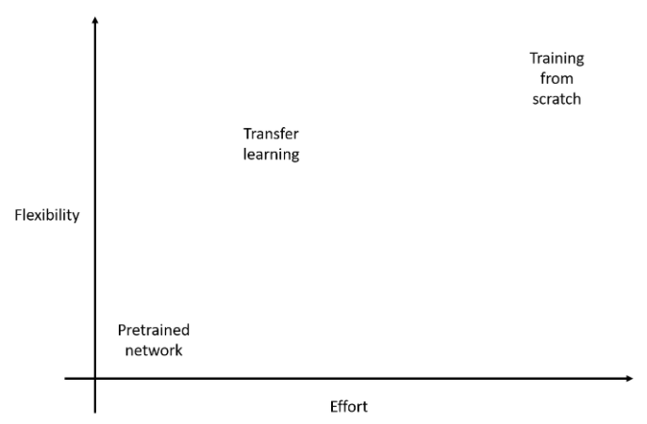
The benefits of transfer learning
Pretrained network:
It is extremely easy to get started using a pretrained network but there is no flexibility in the way the network operates
Training from scratch:
Starting with just the network architecture and random weights, it is possible to get a network suited to a specific problem. However, achieving reasonable results requires experience with network architecture, a huge amount of training data, and a lot of computer time.
Transfer Learning:
Training requires some data and computer time, but much less than training from scratch. The result is a network suited to a specific problem
Notes:
This slide highlights the benefits of transfer learning.
When using a pretrained network, there is no flexibility in the way the network operates. The network probably is trained for a different task.
Training a network from scratch requires knowledge and experience with network architecture, a huge amount of training data, and a lot of computer time
Transfer learning reduces the training time, since it exploits the knowledge of an already trained

Slide 4
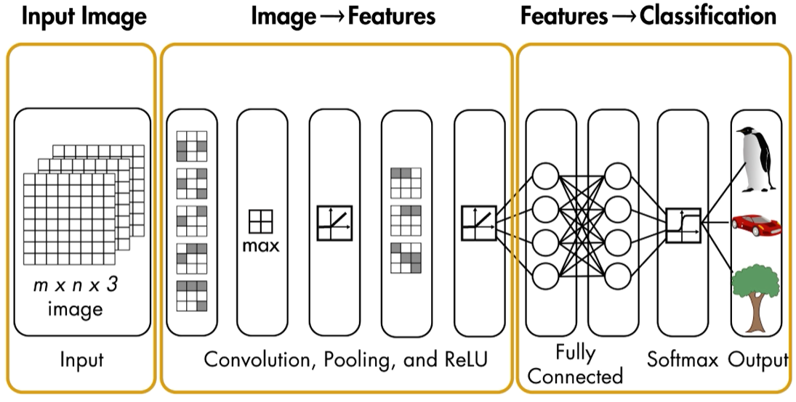
Convolutional Neural Network as features extractor
The first network’s layers turn the input image into a set of features that the last few fully connected layers can use to perform the classification
The idea is to use a pretrained convolutional neural network to extract the features from the input images:
The extracted features are then used to train a different machine learning model (i.e SVM)
The aim is to exploit the features learned on a different task:
first network’s layers usually learn general features like edges, shapes, and textures
Machine Learning Model
Notes:
A convolutional neural network is used to extract features from the input images.
The features are then used to train a machine learning model.

Slide 5

Fine Tuning
A pretrained convolutional neural network is used and modified to fit a different problem
1
The last fully connected layers should be changed to adapt the convolutional neural network to the specific task to solve:
The high-level features of the original network will most probably differ from the features of the new data set
The network may have been trained for a problem with a different number of classes
Since the first few layers learn low-level features, which can be applied to most of the images, the training time can be reduced
Dataset A
Features extraction
Classification
Knowledge transfer
2
Dataset B
Features extraction
Classification
Notes:
When training a network from scratch, the weights are random initialized.
Fine tuning consists in using the weights of a pretrained network as a starting point for the network to train.

